Slide 1
Triangle Cinema Triangle Ticketing Web Application

Slide 2
Product Overview
Triangle Cinema’s “Triangle Ticketing” app is a ticket reservation system
Offers ease of use and flexibility to reserve tickets from anywhere
Intuitive navigation
Modern and responsive design

Slide 3
Intended Audience
General population in the vicinity of Triangle Cinema
Customers who enjoy the convenience of reserving tickets online
Customers who love movies but hate the wait

Slide 4

Architecture
Client-Server : Makes the product easier to maintain as the client is separate from the server
Three-Tier:
Presentation Layer: HTML/CSS
Logic Layer: Django
Data Layer: PostGreSQL
Data-Centric: Database used to update movie information
Event-Driven: Customer clicks buttons to navigate and reserve tickets
Web Browser
Django
PostGreSQL
Google Maps API

Slide 5
Why Django & PostGreSQL?
Django:
Uses Model-View-Template architectural pattern similar to Model-View-Controller pattern
Works with Python code
Has many built in features including Admin interface and forms
Can work with any size project across multiple platforms
PostGreSQL:
Easy to deploy once out of developer mode
Chosen by many Python developers
Well documented resources

Slide 6
Database
We chose the relational database PostGreSQL.
Data populated through the use of Python scripts.
Static data is easily updated by built-in admin read/write or PostGreSQL’s free graphical user interface (GUI).
Tables include Movie, Auditorium, Screening, Seat, Price, and Ticket – all aspects found in a movie theater

Slide 7
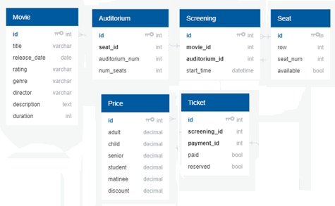
Database Tables

Slide 8

Security
Operating System Security – not handled by Six Pack Consulting.
Database Security – Django-provided admin site and authentication system.

Slide 9
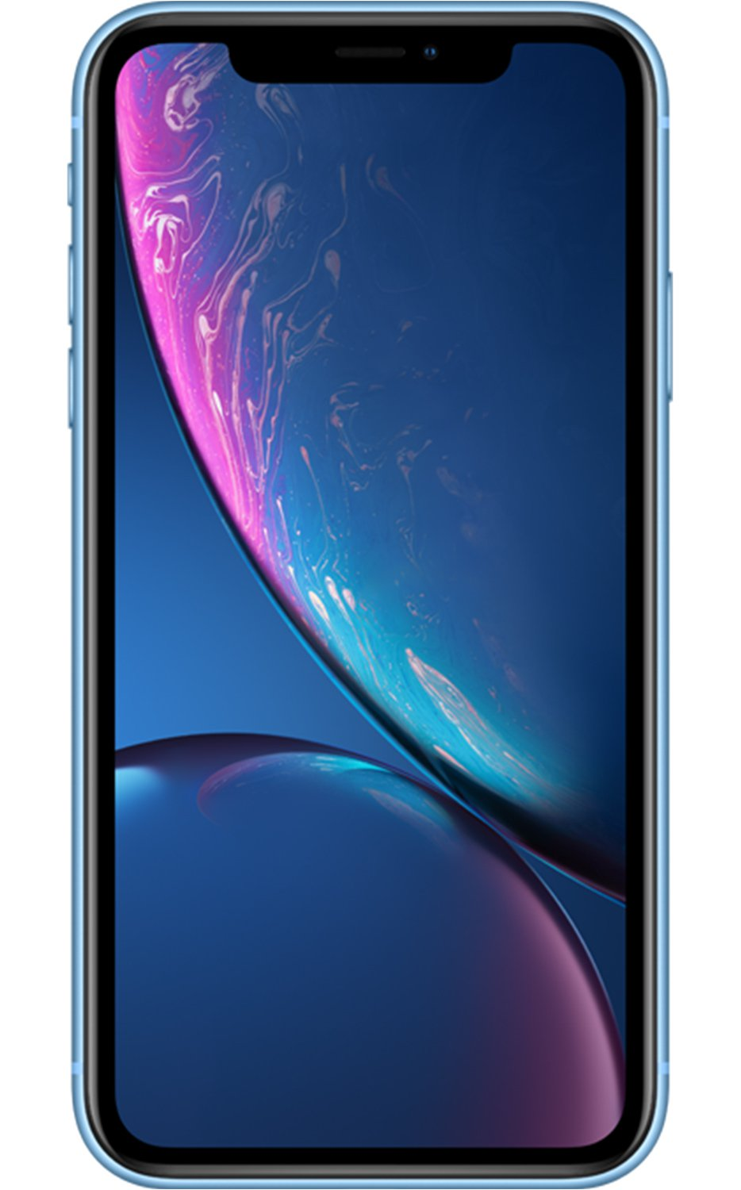
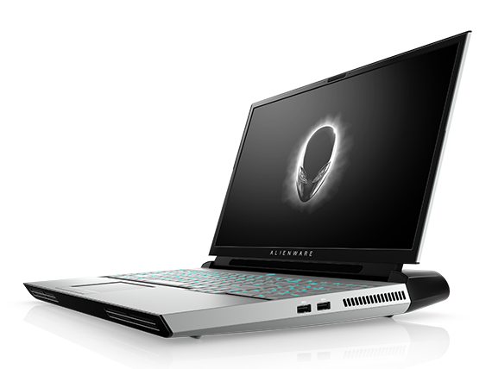
Hardware
The app will run on desktops, smartphones, tablets, or other devices with access to the internet.

Slide 10
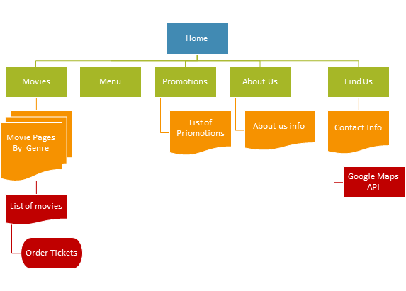
User Interface
No training needed.
Self-explanatory buttons and tabs with clearly labeled names.
Navbar menu at the top of the screen to facilitate navigation between every page.

Slide 11
User Interface
The navbar includes links to the Movies, Menu, Promotions, Find Us, About us, and Contact Us pages.
Clicking on a movie poster’s redirects users to that movie’s details page.
Movie details include movie title, synopsis, rating, and year of release.
Details page also contains a reservation form and a button to submit the data inside of it

Slide 12
Future Updates
Write up reports to gauge website traffic and ticket reservation count
Send reservation confirmations and new promotions to users via email

Slide 13
Learning Outcomes
Teamwork
Perseverance
Preparing for the unexpected
Adapting to change
Communication
Leadership

Slide 14
Resources
Django Tutorials:
https://www.youtube.com/channel/UCWEHue8kksIaktO8KTTN_zg
https://www.codingforentrepreneurs.com/projects/try-django
Django References:
https://djangobook.com/mdj2-models/
Diagram Resources:
https://api.genmymodel.com/

Slide 15
Six Pack Consulting’s Triangle Ticketing App
Reserve your tickets today!

